Slide 1
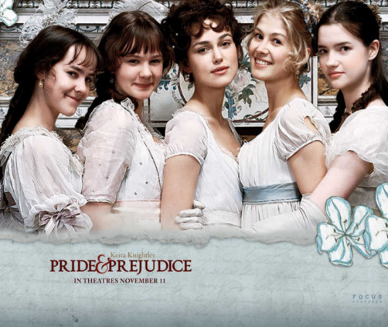
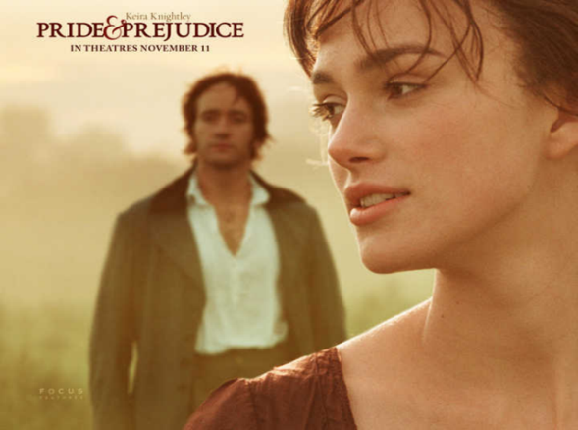
我的感受
Introduction
18世纪后期的英国小说中有一股女性感情潮流，充满伤心流泪的感伤情调和为忧郁而忧郁的嗜好。《傲慢与偏见》克服了这种倾向而接近于现代生活。
同时，奥斯汀在这部小说中通过班纳特五个女儿对待终身大事的不同处理，反映了作者本人的观点。她既反对为金钱而结婚，也反对把婚姻当儿戏。书中的女主人公伊丽莎白对达西先后两次求婚的不同态度，实际上反映了女性对人格独立和平等权利的追求。这是伊丽莎白这一人物形象的进步意义。从女性主义的角度上讲，简·奥斯丁是女性文学的先锋人物，她的创作对于那个时代来讲确实是一个了不起的尝试。
Pride and Prejudice is a novel of manners by Jane Austin in England in the early 19th century. It tells a story of five unmarried Bennet daughters’ life after the rich and eligible Mr. Bingley and his status-conscious friend, Mr. Darcy, have moved into their neighborhood.
高一五班 邵馨妍

Slide 2
My Understanding of Pride and prejudice
高二3班 王子一
Pride and Prejudice is the masterpiece of famous British writer Jane Austen of the 19th century. It is a romantic story of realism which is imbued with 21-year-old Austen’s sharp observation of social lives that makes the style of this book surprisingly mature and lively. The story revolves around the marriage events of 5 daughters in the Bennet family. Mr. Bingley, a new bachelor from London, has fallen in love with the most beautiful and tender Bennet eldest daughter, Jane, and his friend, Darcy, loves the second daughter, Elizabeth. After a series of interesting twists and turns, misunderstandings are finally eliminated with Darcy overcoming his pride and Elizabeth casting away her prejudice against Darcy. At last the two couples get married.
In a sense, the story reflects Austen’s view on marriage, namely, it is fault to marry merely for property and social status though it is also foolish to take these elements into no account. In the story, Mr. Bingley’s sister strongly opposed his plan of marrying Jane because Jane didn’t have much property and her social position was much lower than theirs, from which we can see that there were a lot of obstacles for a not very rich woman to get a wealthy husband at that time due to pressure from friends and relatives. Bearing this in mind, we can understand that it’s quite courageous as well as respectable for Elizabeth to reject Darcy’s first marriage proposal because of his pride and sense of superiority. Being a resourceful and dignified woman, Elizabeth demonstrated her strong attitude of not taking wealth and social status as the main concern in choosing a husband though she later accepted willingly Darcy’s second proposal out of true love.
Thus, by reading this book, I get my lifelong bequest, that is, in the pursuit of true love, we should have a firm belief in the priority of love in choosing a husband or a wife without succumbing to minor concerns like fame, wealth, social status, etc.

